Slide 1
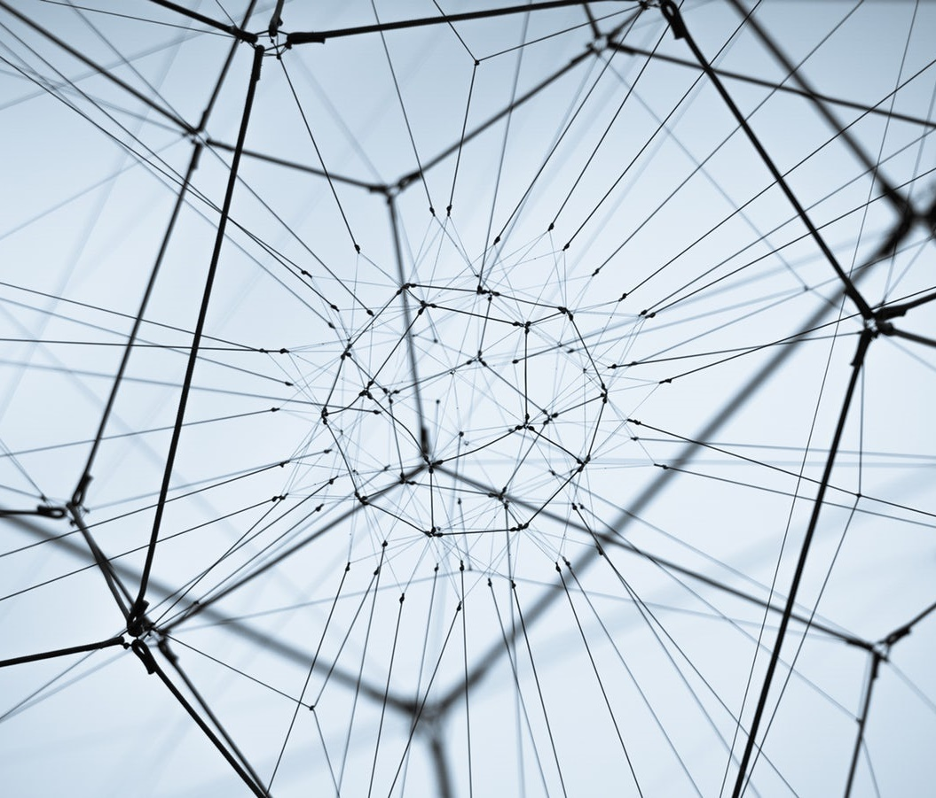
Why you need a reproducible computing environment (and how Binder can help) The #TuringWay team University of Manchester workshop, 1st March 2019

Slide 2
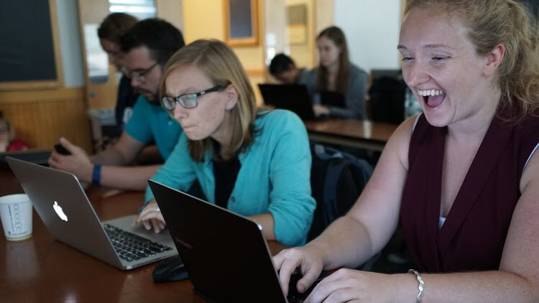
Neurohackweek 2016
Photo credit: Chris Gorgolewski

Slide 3
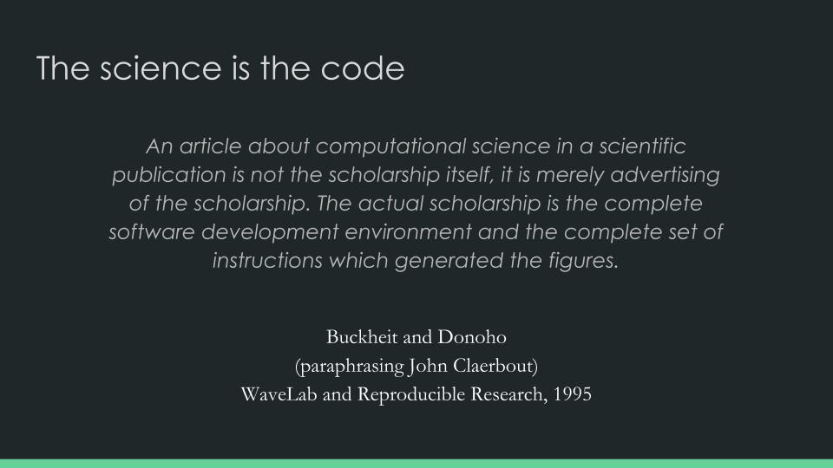
Slide courtesy of Chris Holdraf and the Jupyter Team

Slide 4
What does reproducible mean?
 |  | Data
 |  | Same | Different
Analysis | Same | Reproducible | Replicable
 | Different | Robust | Generalisable
https://dx.doi.org/10.6084/m9.figshare.7140050

Slide 5


Upsetting take home message
Sharing your code and data isn’t enough!

Slide 6
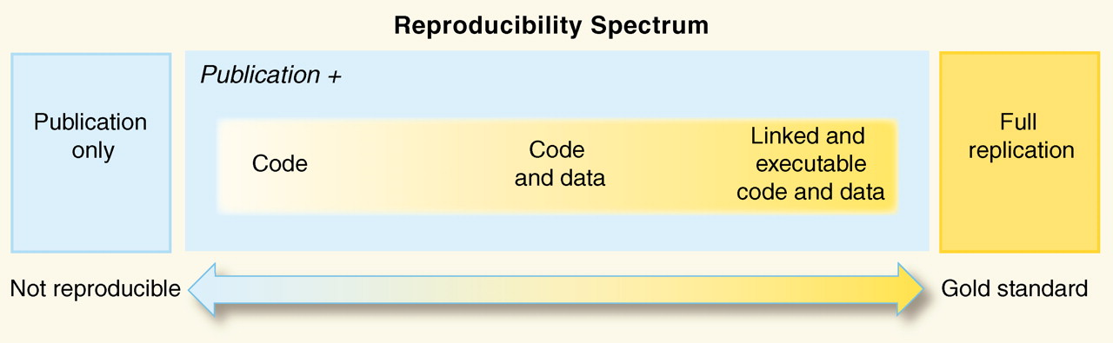
You need the computational environment too
Peng, Science, 2011

Slide 7

You need the computational environment too
Peng, Science, 2011

Slide 8
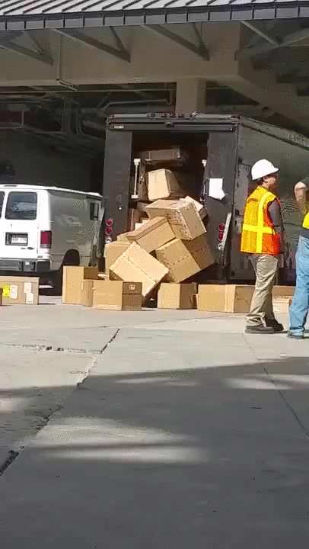
You need the computational environment too
Hardware (GPU, CPU)
Operating system (mac, windows, linux)
Software
Language version
Package versions
And all the interactions between the different layers

Slide 9
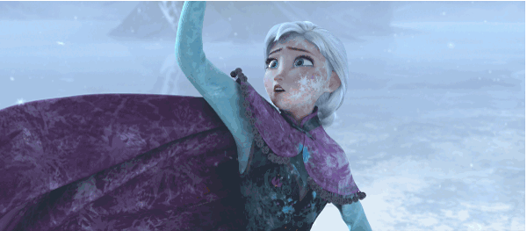
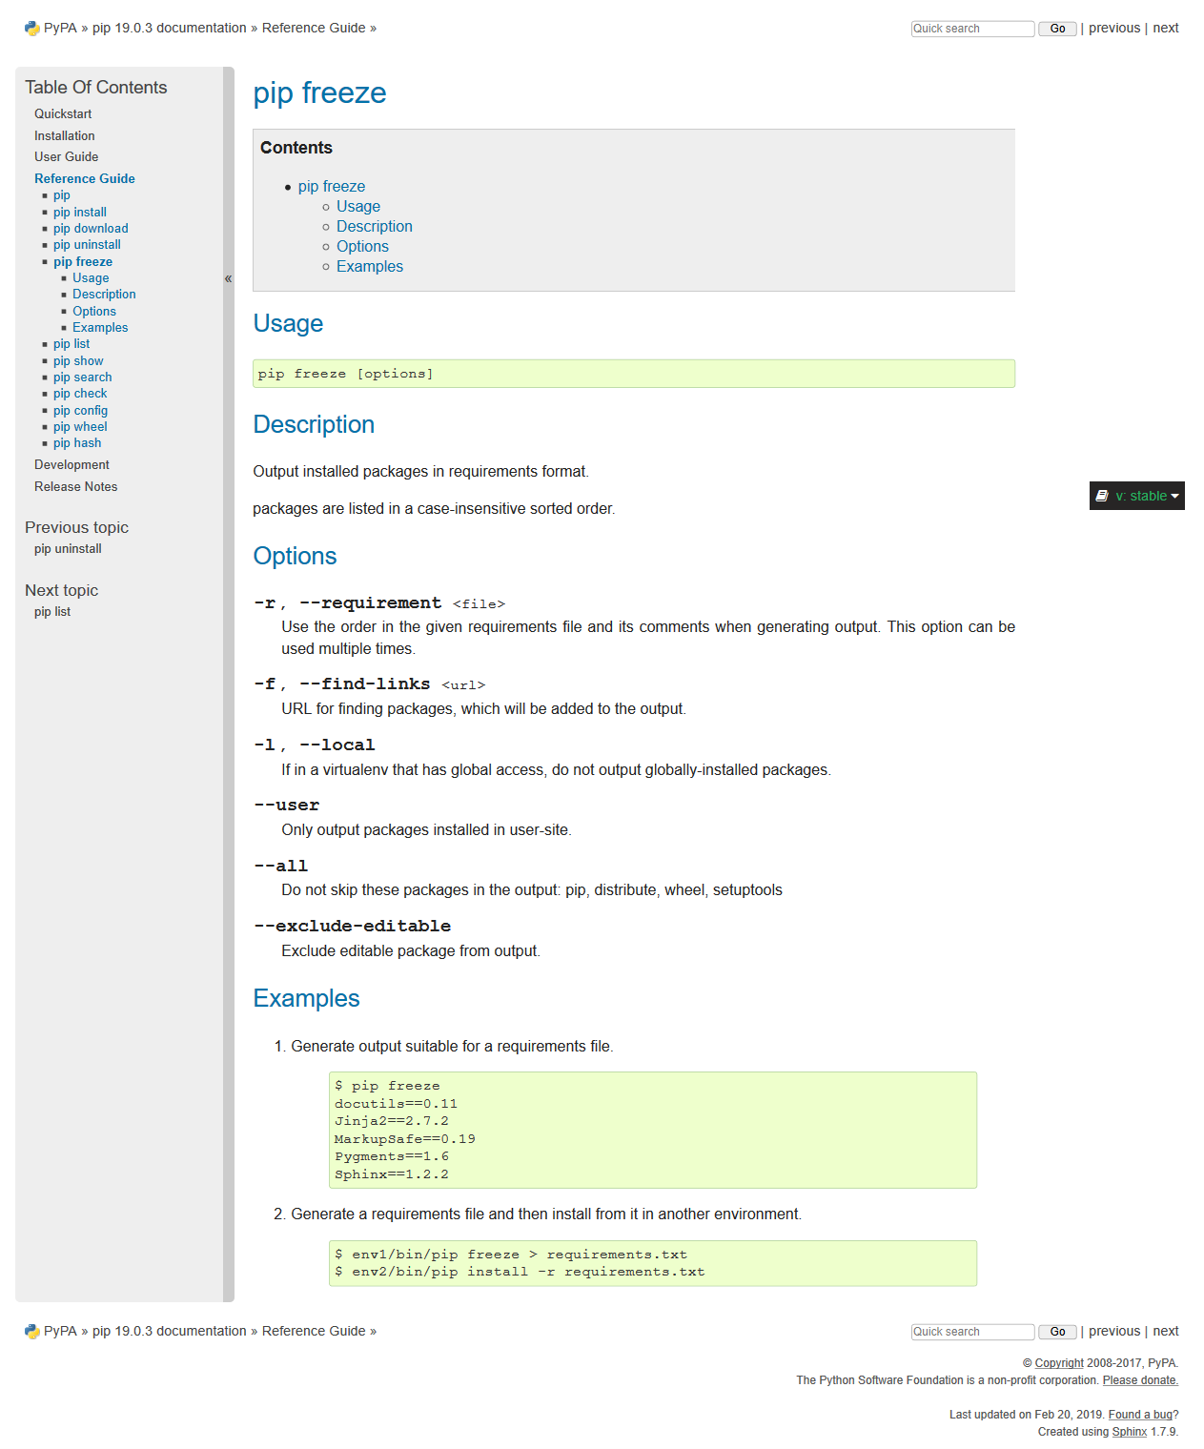
Capturing your local environment
https://pip.pypa.io/en/stable/reference/pip_freeze

Slide 10
Capturing your local environment
https://pip.pypa.io/en/stable/reference/pip_freeze

Slide 11
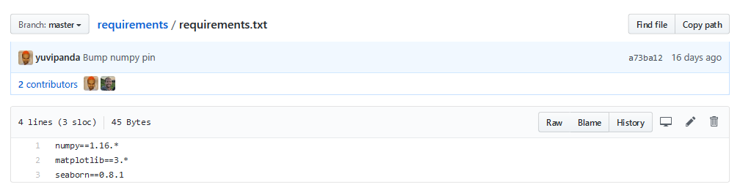
Requirements.txt
https://github.com/binder-examples/requirements

Slide 12
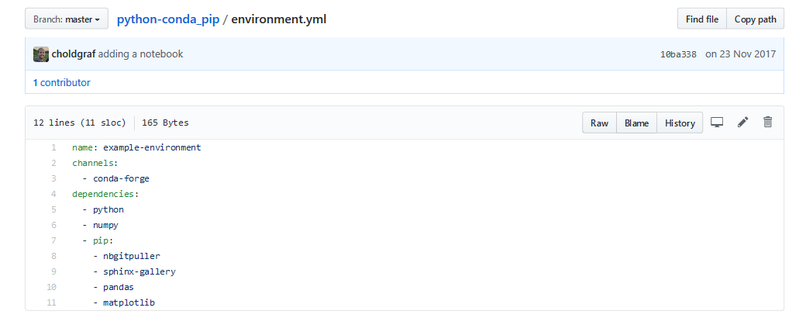
Yet another markup language
https://github.com/binder-examples/python-conda_pip

Slide 13

Yet another markup language
(This is actually a json file in the background)
https://github.com/binder-examples/python-conda_pip

Slide 14
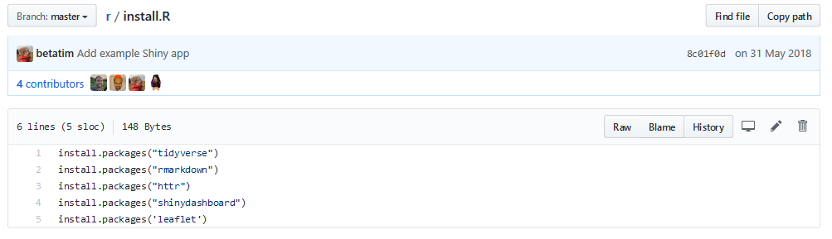
R and RStudio
https://github.com/binder-examples/r

Slide 15
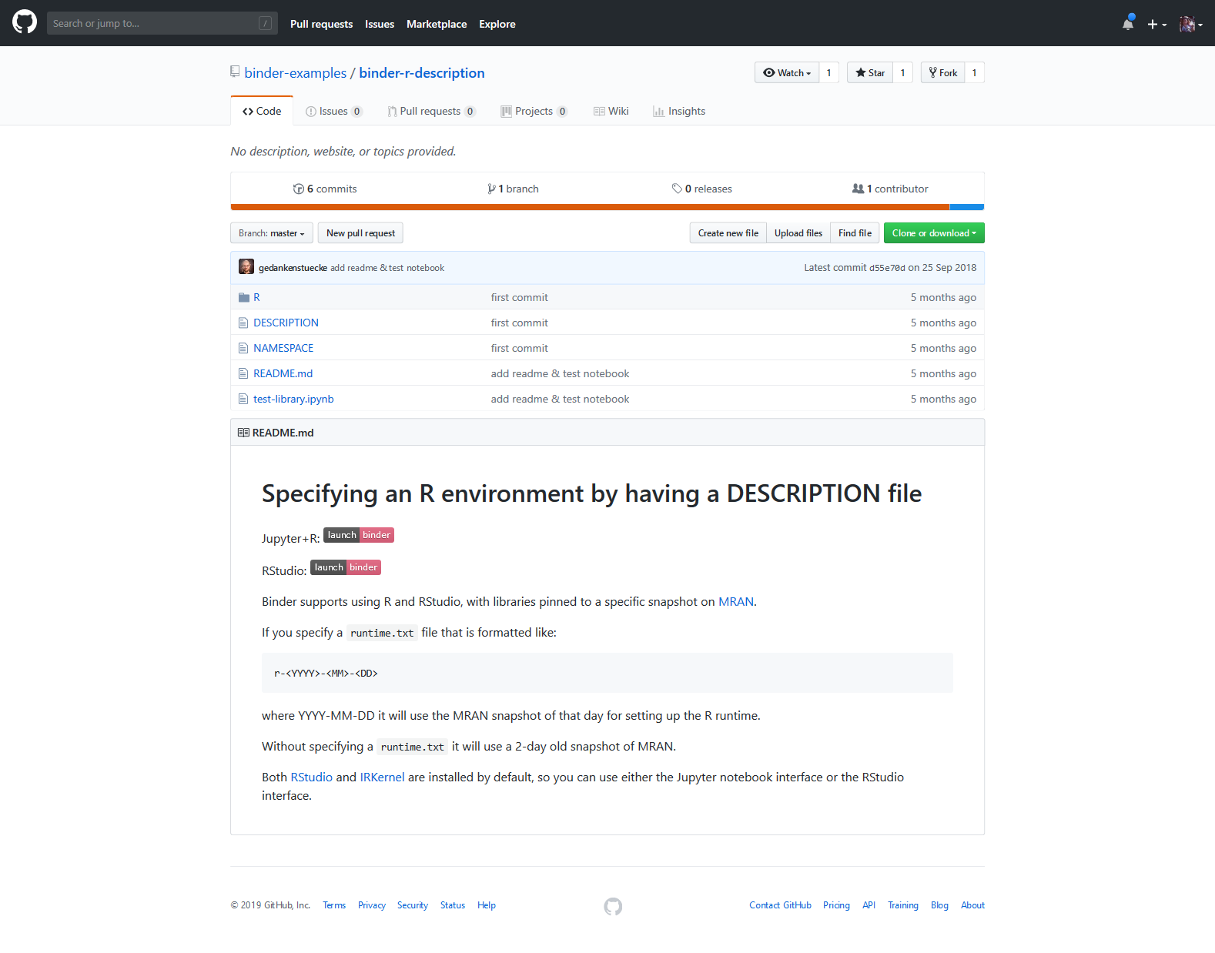
Pinning to a version on MRAN
https://github.com/binder-examples/binder-r-description

Slide 16
Pinning to a version on MRAN
https://github.com/binder-examples/binder-r-description

Slide 17

You could also share this information in the cloud!

Slide 18

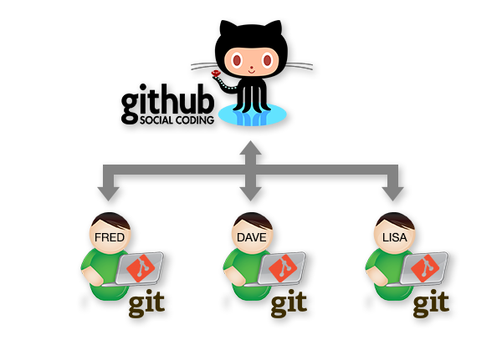
Put your code in the cloud

Slide 19
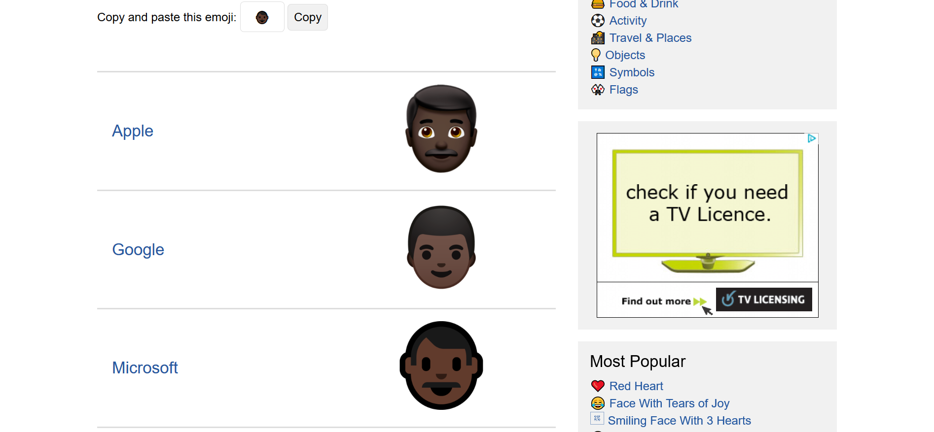
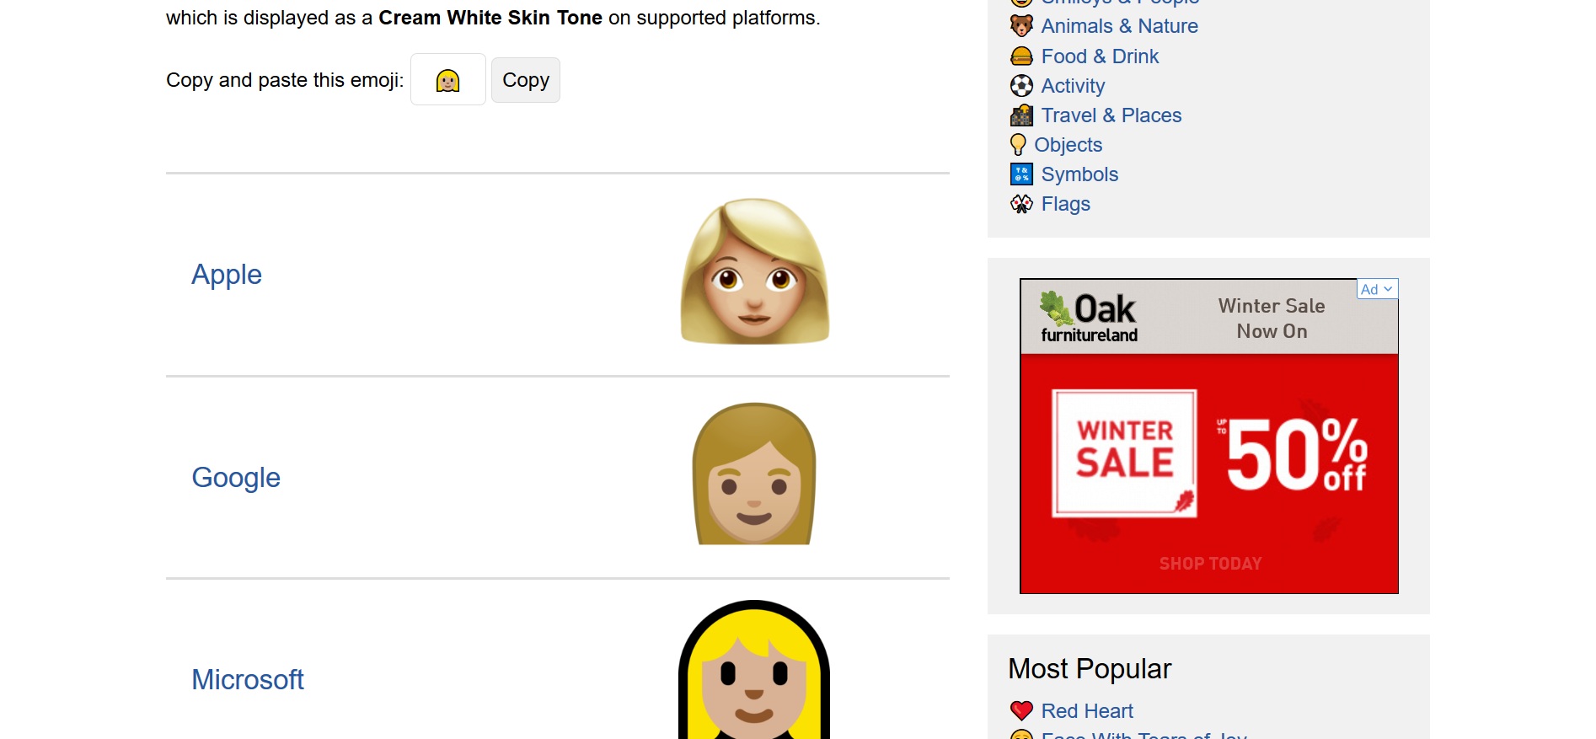
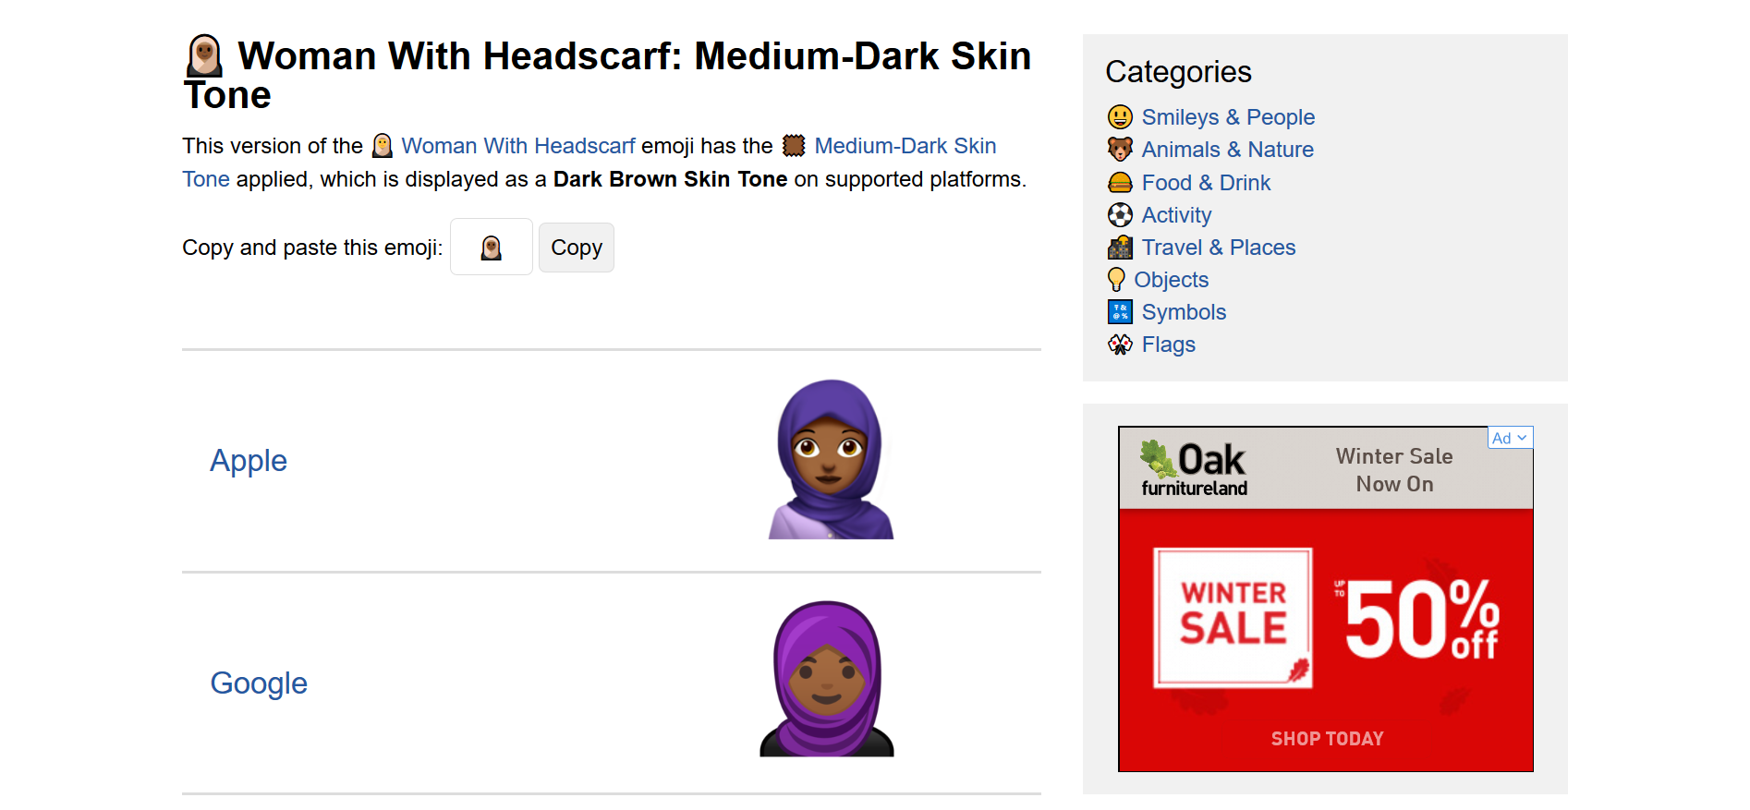
Put your code in the cloud

Slide 20
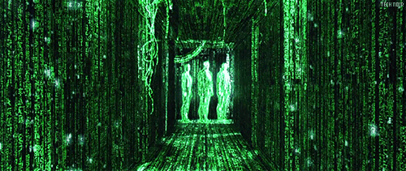
A server is someone else’s computer

Slide 21
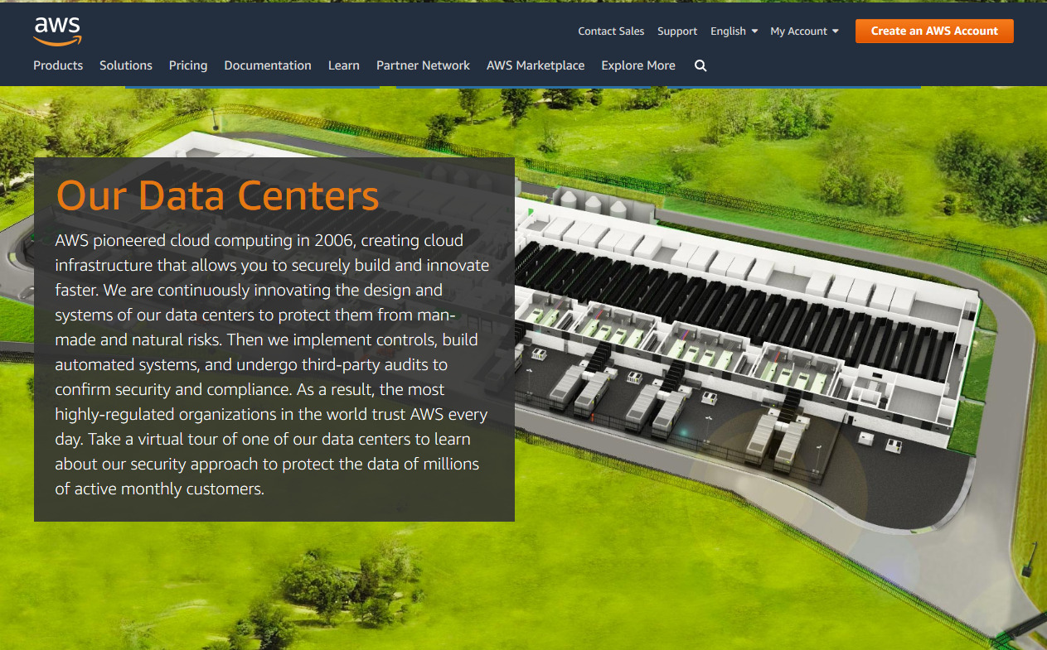
https://aws.amazon.com/compliance/data-center/data-centers

Slide 22
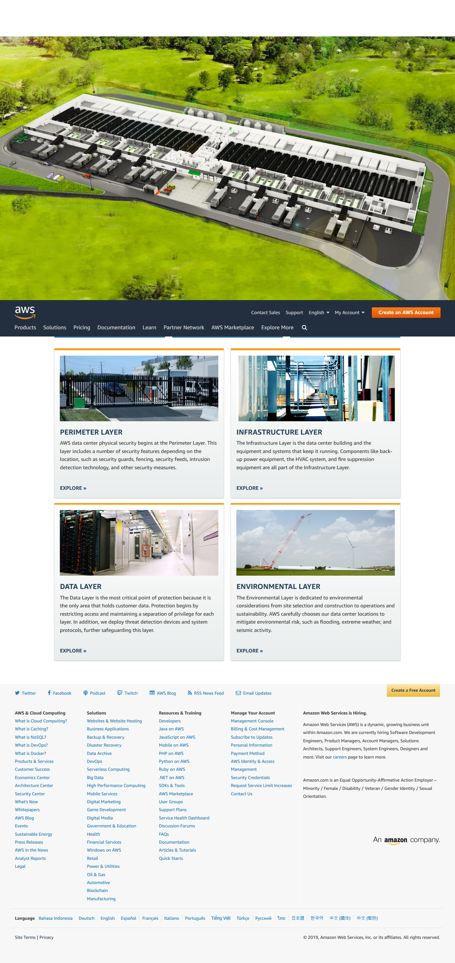
https://aws.amazon.com/compliance/data-center/data-centers

Slide 23
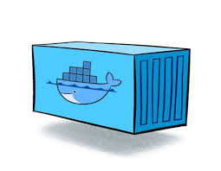
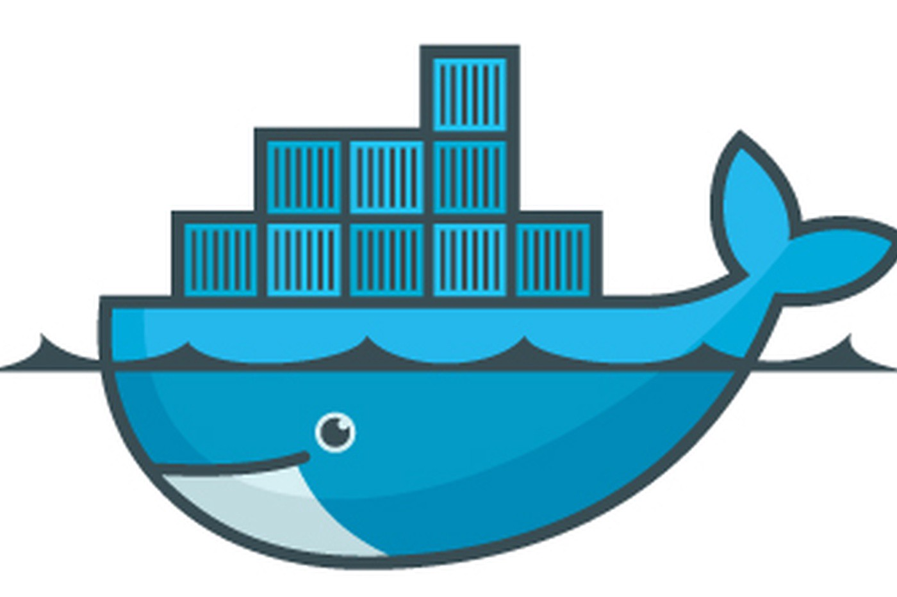
These computers run software
Docker is a container that bundles all the infrastructure and software together.
You don’t have to worry about all the different moving parts, just use the same set up and you’ll be fine.

Slide 24
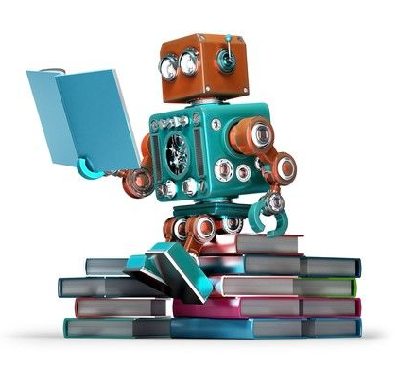

Human and machine readable files
https://medium.com/platformer-blog/practical-guide-on-writing-a-dockerfile-for-your-application-89376f88b3b5

Slide 25
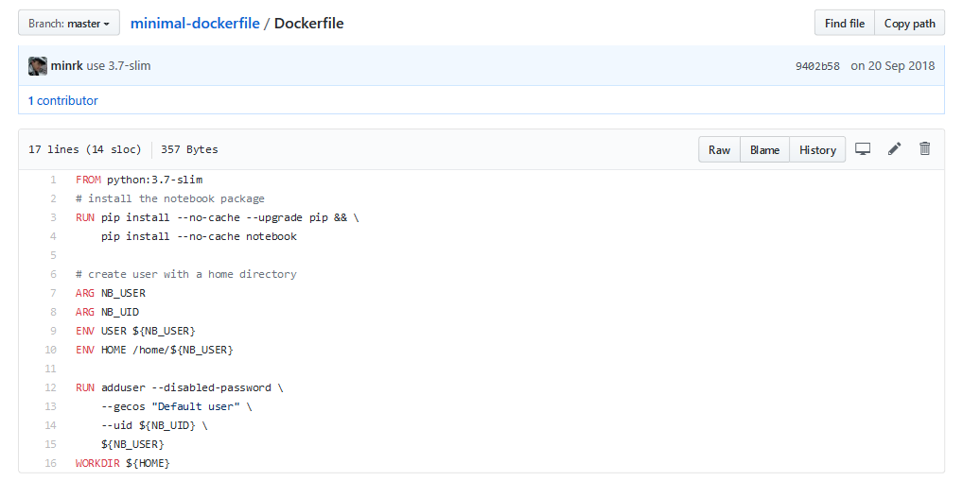
Docker container
https://github.com/binder-examples/minimal-dockerfile

Slide 26
Small group exercise
Please get into groups of 3-4 and explore the examples below.
Try to answer:
Are there differences between different branches?
Does that give different results?
Did you get what you’d expect?
https://github.com/annakrystalli/breaking_dplyr
https://github.com/binder-examples/matplotlib-versions
https://github.com/sgibson91/CompEnv-PairedExample-1
https://github.com/KirstieJane/CompEnv-PairedExample-2

Slide 27
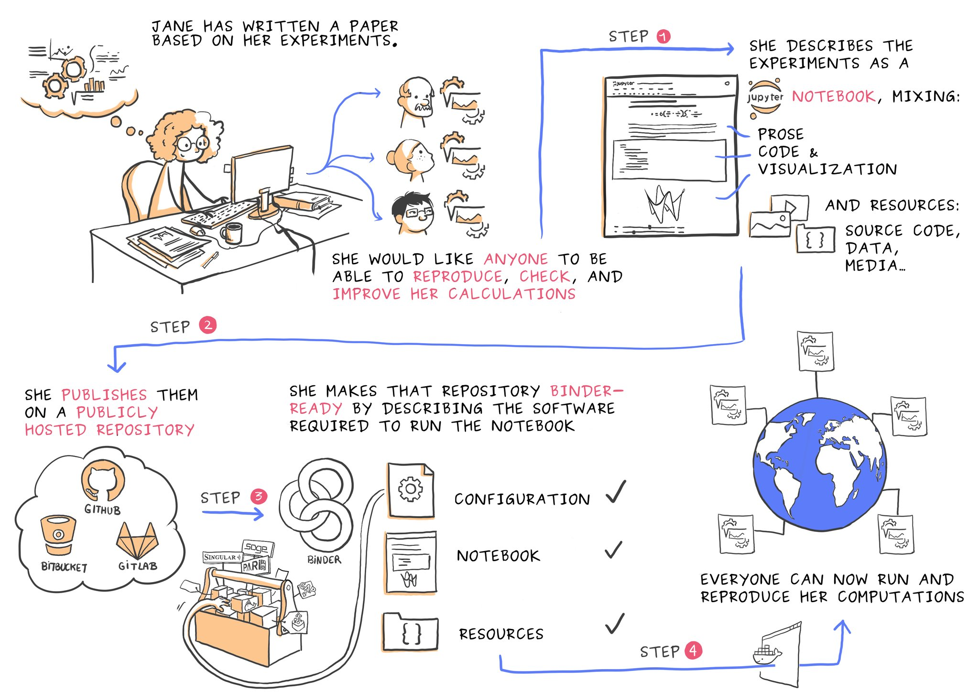
Courtesy of Juliette Belin: https://twitter.com/JulietteTaka/status/1082735653929000960

Slide 28

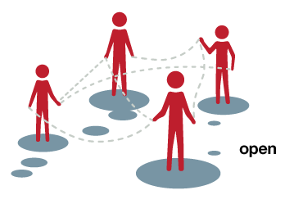
Courtesy of Juliette Belin: https://twitter.com/JulietteTaka/status/1082735653929000960
This Photo by Unknown Author is licensed under CC BY

Slide 29
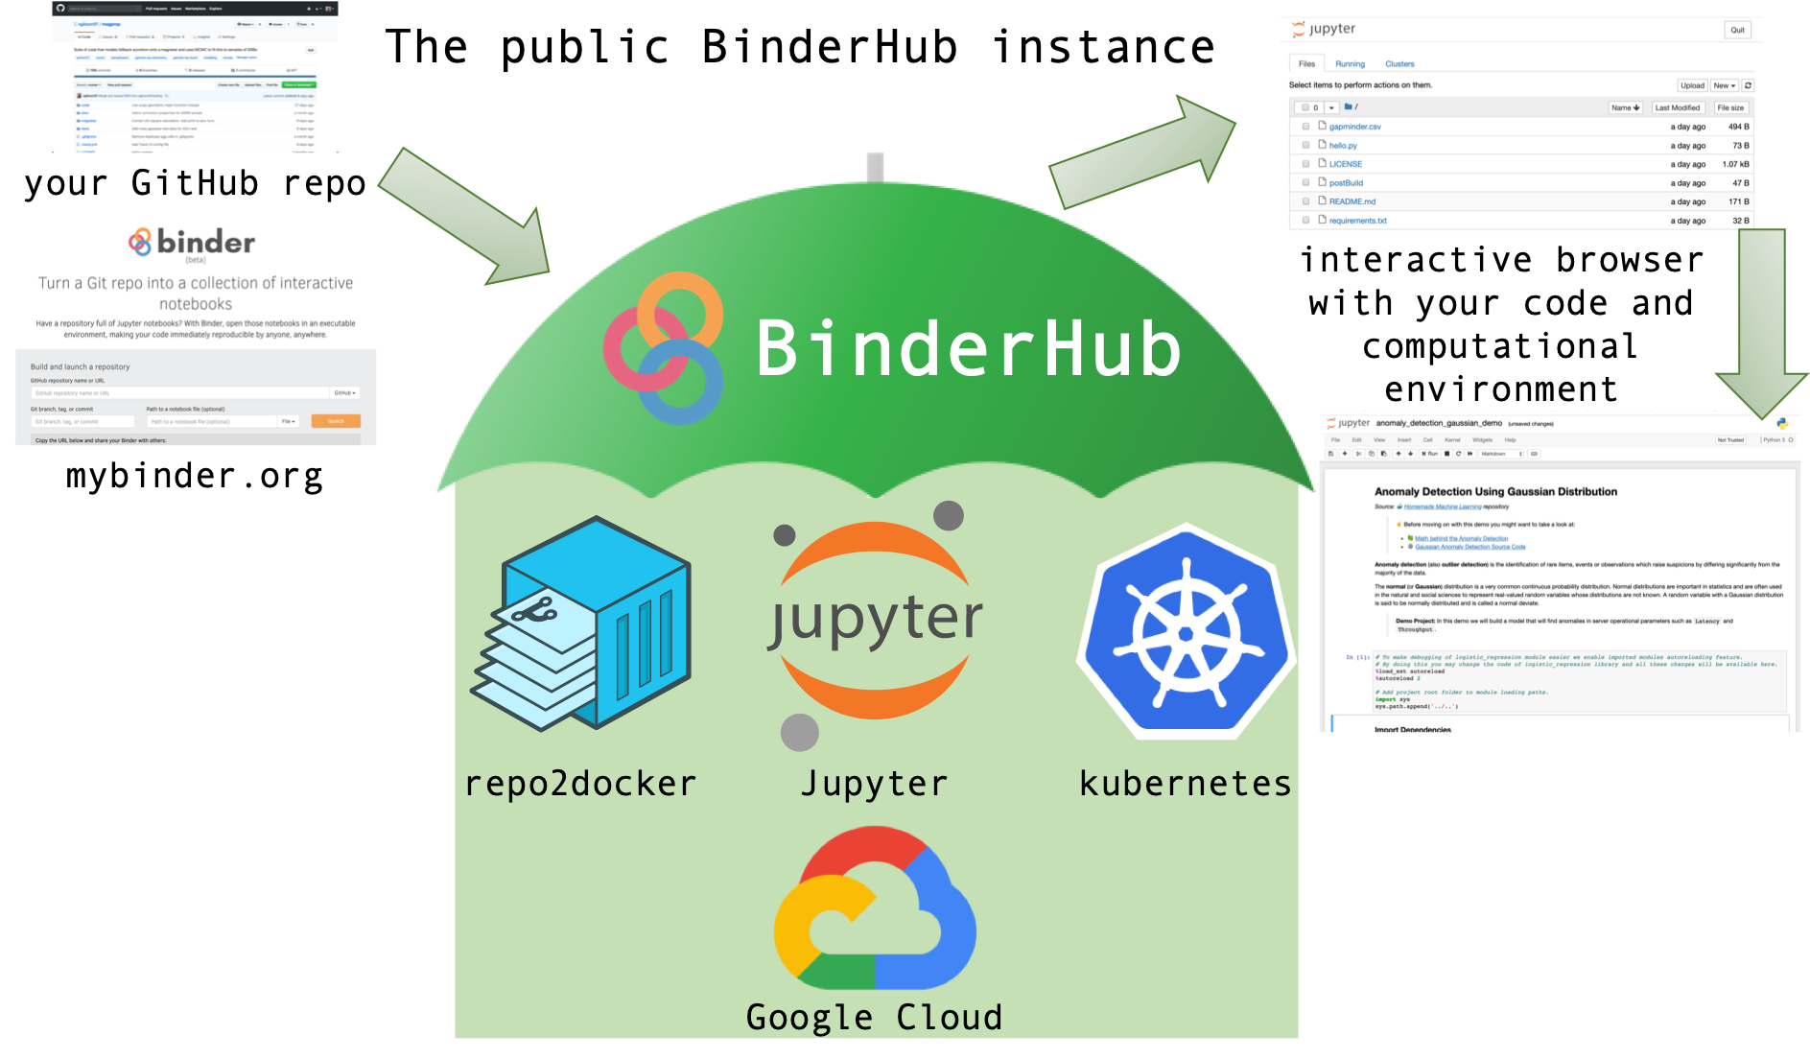

Slide 30



The Turing Way
#TuringWay https://github.com/alan-turing-institute/the-turing-way
gitter.im/alan-turing-institute/the-turing-way

